Slide 1
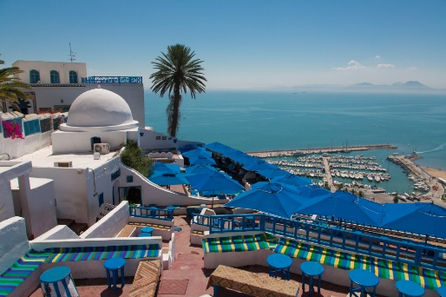
Department of Modern and Classical Languages French Program

Slide 2
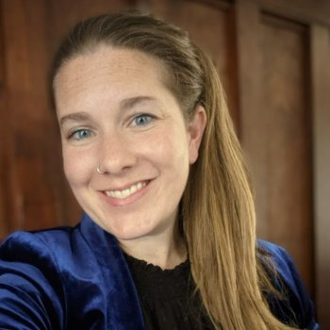
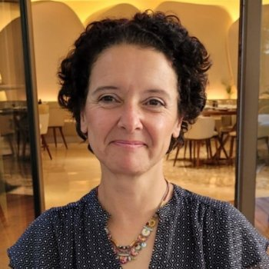
Lindsey Smith Andrea Predko
Anthony Radoiu
Cécile Hanania

Slide 3
The French section of the Department of Modern and Classical Languages offers courses in language, linguistics, literature, and culture. Students of French acquire the skills required to not only speak the language, but also to learn about and appreciate Francophone societies, cultures, and artistic expressions.

Slide 4
FRENCH ADVISOR
Fall 2023
Cécile HANANIA
French Advisor/Study Abroad Advisor
hananic@wwu.edu | 360-650-4858
Fall Office Hours
By appointment only at https://calendly.com/cecile-office
Monday 4:00-6:00pm (Zoom or in-person in MH 126)
Wednesday 5:30-6:30pm (Zoom only)

Slide 5
Where is French spoken ?

Slide 6
French is spoken in over 50 countries, making it one of the most widespread languages of the world. It is estimated that the number of first- and second-language speakers of French worldwide is about 230 million people. It is an official, co-official, or de facto national language of 29 countries. Countries using French as either a first or a second language are located on four continents. Four of them are in Europe: France, Belgium, Switzerland, and Luxembourg. Two are in the Americas: Canada and Haiti. There are also several overseas departments (Martinique, Guadeloupe, La Réunion, Mayotte, and French Guiana) and territories (French Polynesia, Wallis and Futuna, etc.) of France. Several countries in Africa and Asia have a strong Francophone presence. French is a major second language in Arabic-speaking Algeria, Tunisia, and Morocco. Africa has a large and growing population of French speakers, with the number of first-and second-language speakers exceeding 100 million.
French is one of the official languages of the United Nations (UN), the North Atlantic Treaty Organization (NATO), and the European Union (EU). The International Francophone Organization includes 84 member states and governments (58 members and 26 observers).
French is one of the most studied foreign languages. In the US, French is the second most-studied foreign language in schools, after Spanish.

Slide 8
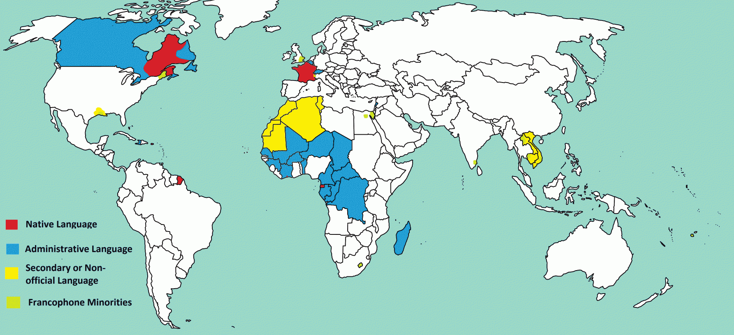
Study Abroad
We offer a variety of programs that provide educational experiences for students to live and study in another French-speaking country. Special application and registration procedures are required for participation in foreign study programs, and students should consult with the Education Abroad office, Miller Hall 208, well in advance of their planned quarter abroad, as well as with the study abroad advisor of the language section to discuss transfer credit. For info go to https://studyabroad.wwu.edu/map/french-language

Slide 9
Western sponsors and is affiliated with several Study Abroad programs. See Education Abroad for more information. https://studyabroad.wwu.edu/
Helpful Links
CampusFrance https://www.usa.campusfrance.org/
Étudier en France https://www.diplomatie.gouv.fr/fr/venir-en-france/etudier-en-france/article/etudier-en-france
AATF Walter Jensen Scholarship for Study Abroad https://frenchteachers.org/promote-french/scholarships/
Seattle-Nantes Scholarships https://www.seattle-nantes.org/scholarships
Consulat Général de France à San Francisco https://sanfrancisco.consulfrance.org/

Slide 10
Requirements for a Minor in French
30 credits above the 100 level
Maximum of 15 credits at the 200 level
GPA of 2.50 or above in minor
At least 50 % of the credits required for the minor must be earned at WWU
C- is the minimum grade needed for a class to count for the minor
French 425 is not applicable to minor
Required Courses
French 301 (Grammar Review and Composition). Only taught in fall
Two other upper-level French courses. French 385 (Culture and Conversation) is not repeatable for credit for minor.

Slide 11
A French Major is just 6 classes away…

Slide 12
Requirements for a Major in French
Link to the catalog French BA https://catalog.wwu.edu/preview_program.php?catoid=16&poid=7472&hl=%22french%22&returnto=search
60 credits above the 100 level
Maximum of 15 credits at the 200 level
GPA of 2.50 or above in major
At least 50 % of the credits required for the major must be earned at WWU
C- is the minimum grade needed for a class to count for the major
French 425 is not applicable to major

Slide 13
Required Courses
French 301 (Grammar Review and Composition). Only taught in fall
French 314 (Phonetics)
French 331 or 332 (Culture and Civilization)
Two of French 340, 341, 342 (French Literature)
French 385 (Culture and Conversation). The course is repeatable for credit; 10-credits maximum including original course)
French 401 (Advanced Composition). Usually taught in fall
One other 400-level French course
At least one 400-level course must be taken at Western
Note that in addition to all the required courses, 20 elective credits in French are needed to complete a major in French.
Those credits can be obtained by taking the French 200 level courses and any French 300 or 400 level course not already completed as a required course (for majors FR 385 is repeatable for a max of 10 credits provided that the subject matter is different each time)

Slide 14
Advanced Placement Credits
Students who enter at the 301-level may request AP credit from the department for courses (GURs) numbered 201, 202, and 203 upon successful completion of FR 301 and another 300 level French course with at least a B in each course.
At least 50 % of the credits required for a major or minor must be earned at WWU.

Slide 15
FR 425: Teach Learn Elementary French
Prerequisites:
Written permission from instructor and two upper-division French courses.
Credits:
-In order to get the two credits for the course, students will have to tutor beginning French students 4 hours a week throughout the quarter.
-Schedule arrangement needs to be discussed with instructor.
-Students can register only twice for the course (max 4 credits).
-Credits are not applicable to minor or major but count as upper-level credits for WWU degree requirements.

Slide 16
Can I do a dual or double major?
YES !
80% of the students majoring in French are completing another major.

Slide 17
Dual and double Major
Dual Major in French and another Language
50 credits for each major. (See catalog for details)
French/Spanish https://catalog.wwu.edu/preview_program.php?catoid=16&poid=7474&hl=%22french%22&returnto=search
French/German https://catalog.wwu.edu/preview_program.php?catoid=16&poid=7473&hl=%22french%22&returnto=search
Double Major in French and Linguistics
See Linguistics advisor for info.
Double Major. Other popular combinations with a French major are:
International Business
Journalism
History
Political sciences
Environmental studies
If you wish to do a dual or double major it is important that you meet with the advisors in both programs or departments to draft a study plan ahead of time

Slide 18
What is a French Major with Teaching Endorsement?

Slide 19
French Major with Teaching Endorsement
Why Consider a Teaching Endorsement in French Major?
The BA in French leads to a BA degree without teacher certification. In order to receive a recommendation for state of Washington certification students must complete the “teacher certification” program which is offered by the Department of Secondary Education.
Requirements:
70 credits (58 additional credits for teacher certification)
Language requirements
French BA (60 credits)
Note: FR 401 (Advanced Composition) and LANG 401 are only offered in fall. See schedule in advance or talk to advisors to carefully plan your future registration.

Slide 20
How and when to declare ?

Slide 21
Procedure for Declaring a Major or Minor in French
Typically students declare a minor or major in French after or near completion of
FR 202, FR 203 or FR 301.
First meet with the French advisor.
Then complete the declaration form online.
Complete section 1 then enter advisor email: hananic@wwu.edu and click submit
MINOR https://esign.wwu.edu/forms/Registrar/_minor_decl_and_change_5.aspx
MAJOR https://esign.wwu.edu/forms/Registrar/_major_decl_and_change_9.aspx

Slide 22
Plan of Study for Students Majoring in French
When declaring their major in French, students should carefully review with the French advisor their plan of study, the requirements for the French BA, the course offerings for future quarters and the prerequisites for upper-level French courses to ensure that they have enough quarters ahead of them to complete the major. (For instance, students declaring a major in the fall when in FR 301, unless studying abroad, will need at least 4 additional quarters –Winter/Spring/Fall/Winter– to complete their major in French. Note that French upper-level courses are seldomly offered in the summer)
Due to the structure of the program and staffing limitation, Independent Studies in French are only allowed for 1 or 2 credits. Students can obtain these credits by taking a regular French course and completing additional assignment(s) for credits. Independent Study cannot be taken in lieu of a course offered during the year.
FR 401 is only offered in the fall and is a requirement for all 400-level seminars.

Slide 23
TAPIF
Teaching Assistant Program in France
The French Ministry of Education offers paid teaching assistantship positions in French primary and secondary schools to American citizens every year. The Assistantship application for the following school year is posted in the Fall quarter. https://www.tapif.org/
2 years of French minimum. Minimum of three years of higher education. Your chance to get into the program will increase with a minor in French and moreover a major.

